Slide 1
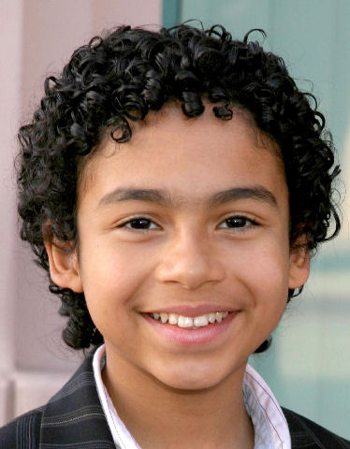
My Heritage
By John Doe

Slide 2
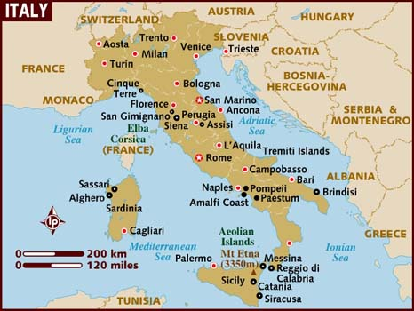
My ethnic background is…..
Italian. This is a map of where my heritage is located.

Slide 3
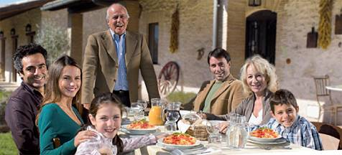
This is a picture of my ethnic country and my family.

Slide 4
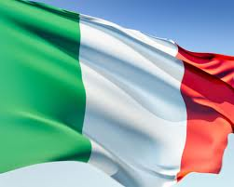
The heritage I identify most with is….
Italian because my mother and father are both Italian. Their parents are from Rome, Italy. My mom and dad parents moved here when they were small.

Slide 5
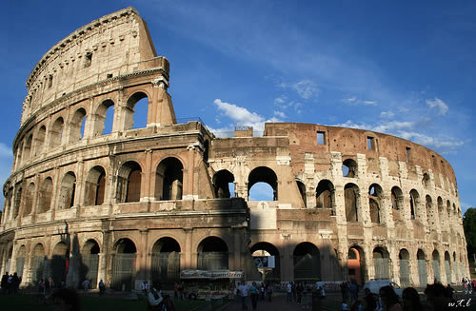
Some things about the country that best represents my heritage are…. The art and structures.

Slide 6
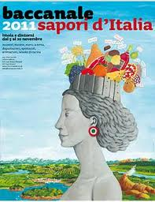
Our favorite cultural family activity is…
The Baccanale of Italy. It is a festival of foods. We love to go taste the different foods that people have created.

Slide 7
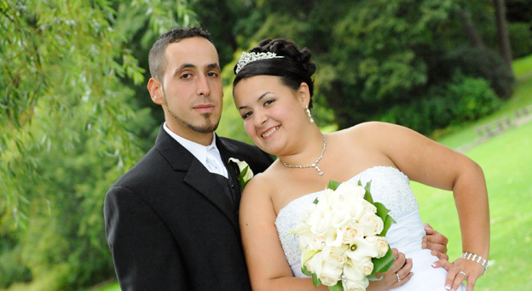
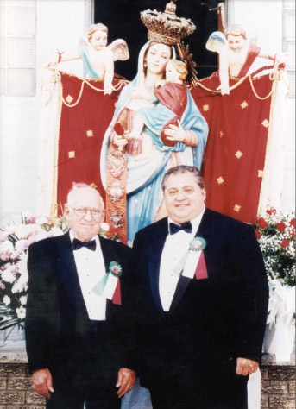
My ancestors came to America because…..
My grandfather’s were offered a job that paid more money in America than they made in Italy. They saw it as a great opportunity for my parents to have a better life.

Slide 8
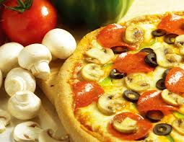
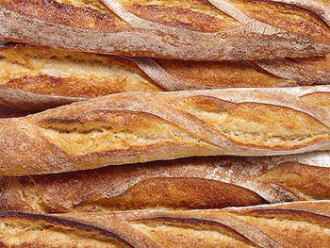
Some cultural foods…..we love to eat pasta. Pasta and pizza is a favorite italian food. Fresh bread is also something we love to eat

Slide 9
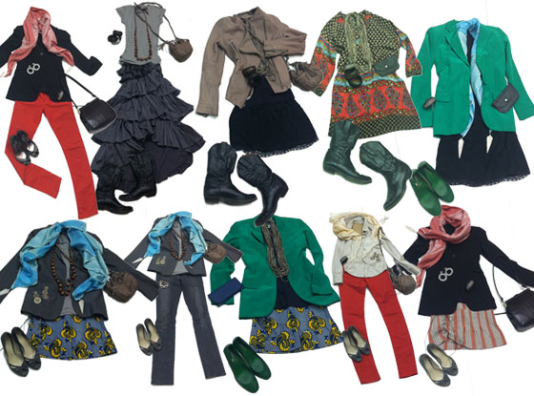
A lot of people like the clothes from italy. There are some name brand designers from italy.

Slide 10
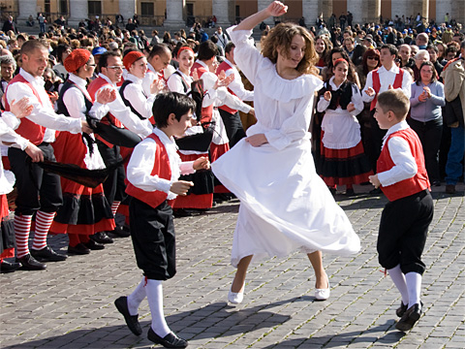
Dance is very big in italian culture. You will often see people performing in the streets.

Slide 11
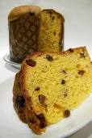
Cultural Traditions….
The Panettone is a traditional Christmas cake that is given as a gift in Italy. It was started a long time ago by a baker who had burned the cakes to offer as dessert for a king. The guest enjoyed it and it has become a tradition to give the cake as gifts.

Slide 12
Other interesting Facts…
Italy is a great place to ski. It has big mountains and hills.
Christopher Columbus was from Italy and sailed to discover America.
Pizza is one of the most famous Italian dishes.
The country of Italy is shaped like a boot.

